Slide 1
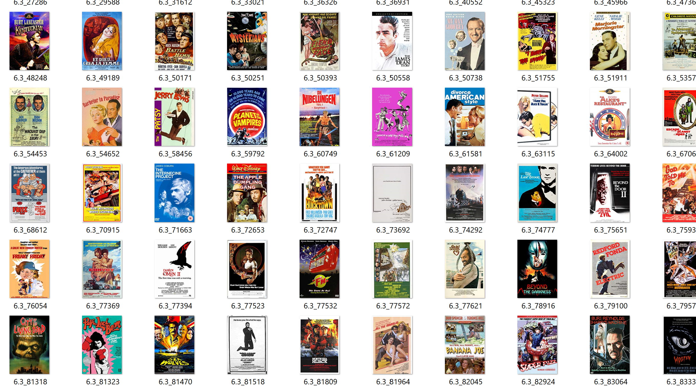
Movie Posters Manifolds
Theo Cucu
9.S912
Fall 2023

Slide 2

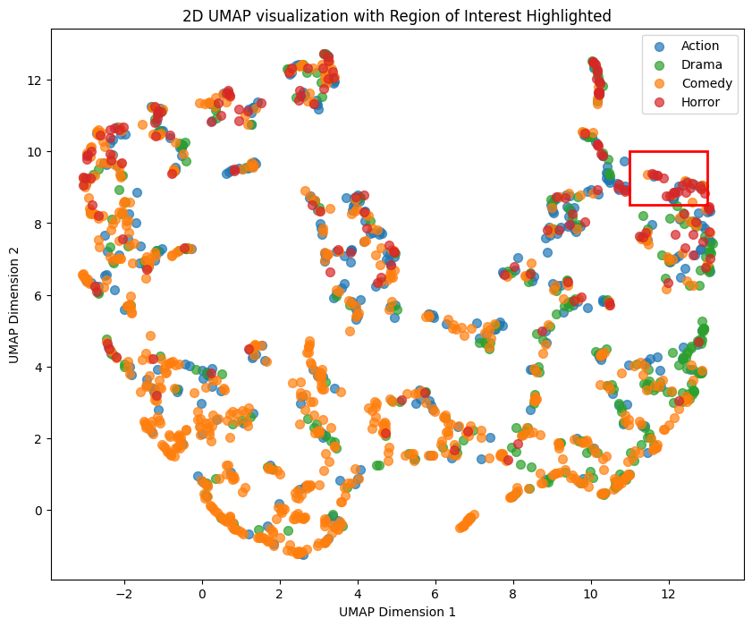
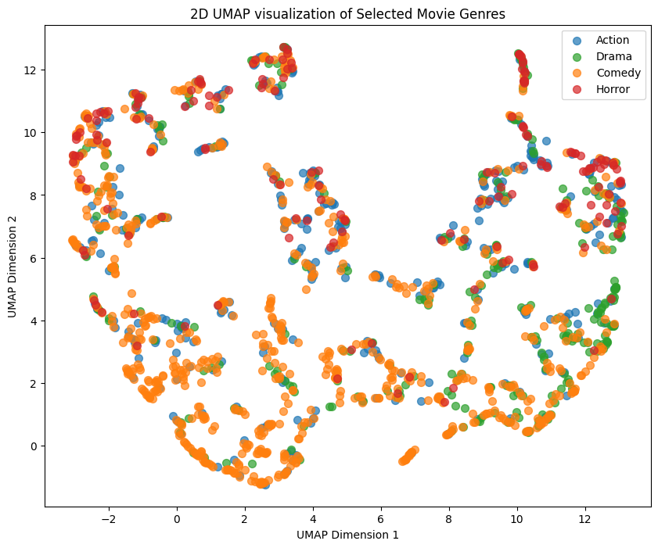
UMAP: Uniform Manifold Approximation and Projection for Dimensionality Reduction

Slide 3
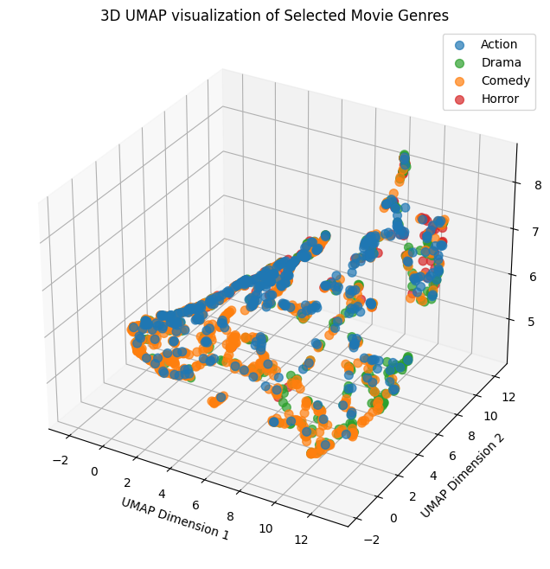
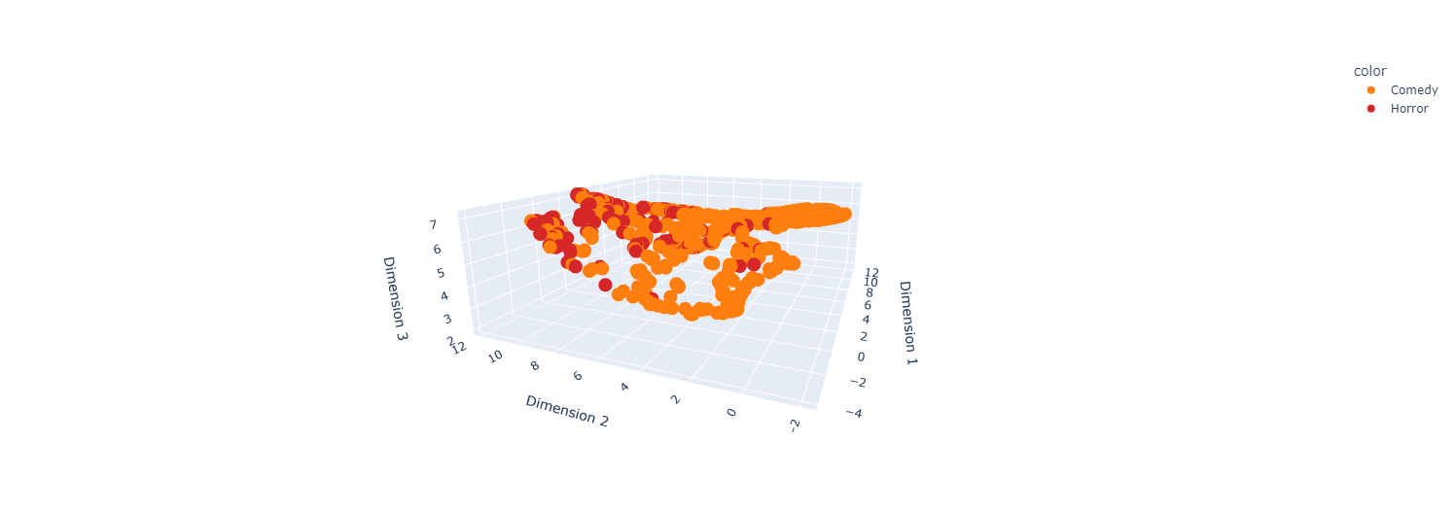
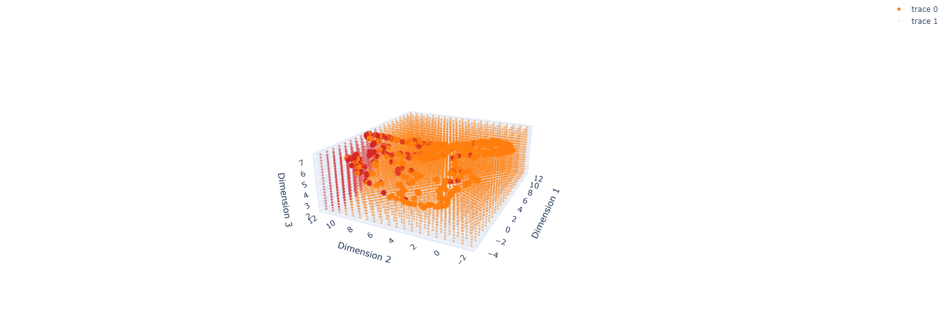
Looking for manifold in 3D
Separating Comedy from Horror: Non-linear decision boundaries from SVM with RBF (radial basis function) Kernel – 85.3% Accuracy

